Slide 1
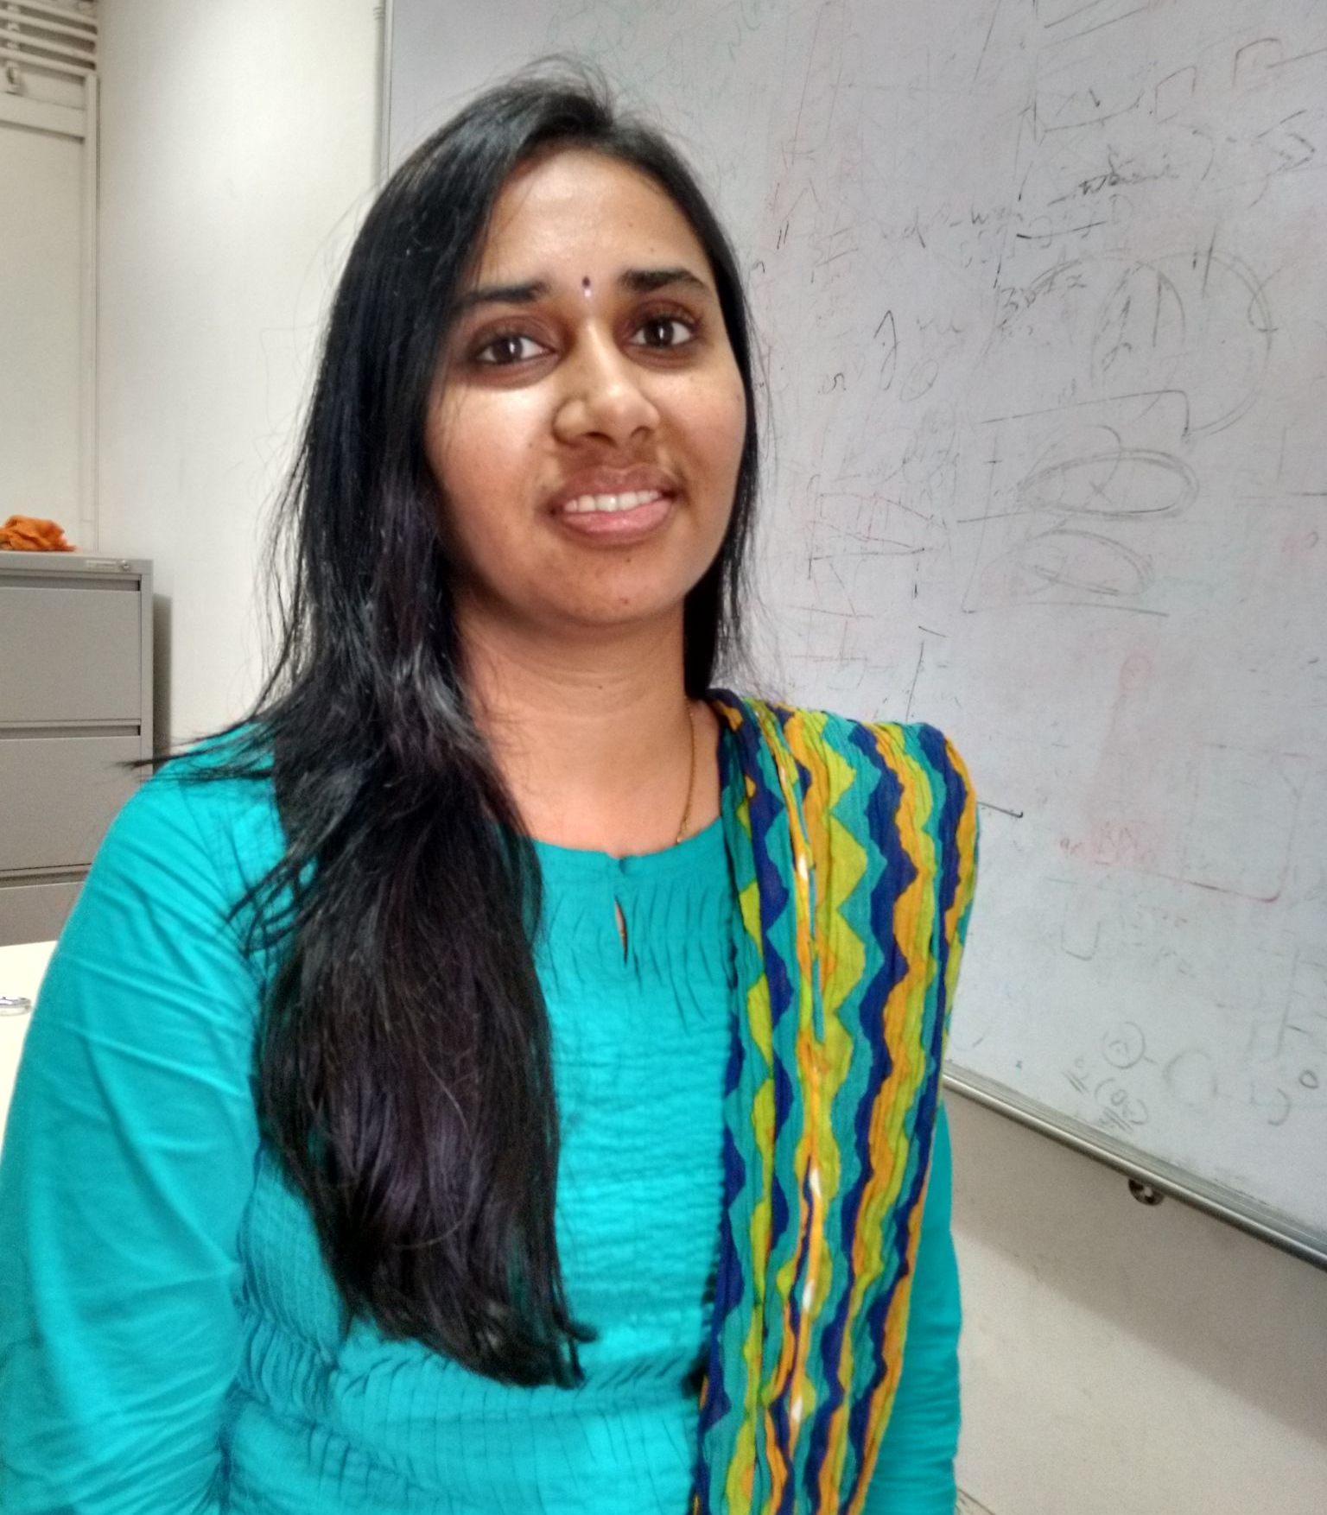

Overview of Common Neural Network Compression Techniques
Sriranjani Ramakrishnan
Google Developer Expert in Machine Learning
India

Slide 2
Why do we need to Compress Neural network model?

Slide 3
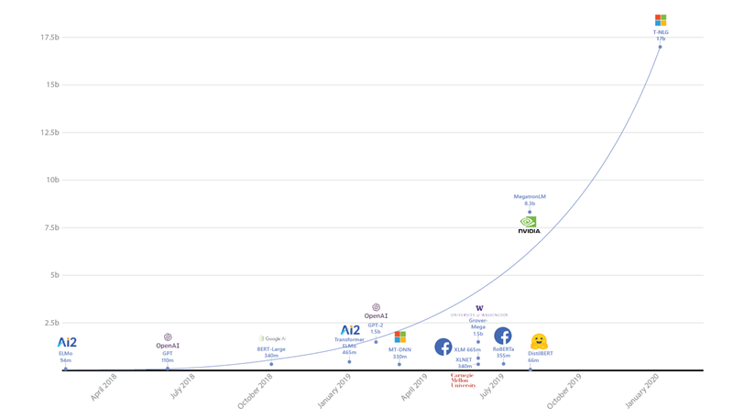
Increasing Size of Neural Networks models
T5: 11B
T-NLG: 17B
GPT3: 175B
GShard – 600B – 1T
ImageSource: https://www.microsoft.com/en-us/research/blog/turing-nlg-a-17-billion-parameter-language-model-by-microsoft/

Slide 4
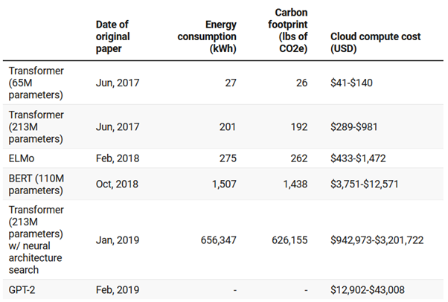
Increasing Carbon FootPrint
Image Source: https://www.technologyreview.com/2019/06/06/239031/training-a-single-ai-model-can-emit-as-much-carbon-as-five-cars-in-their-lifetimes/

Slide 5
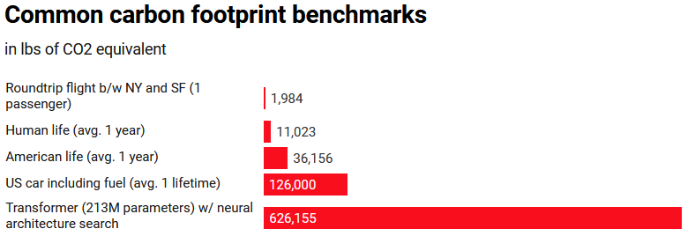
Increasing Carbon FootPrint
Image Source: https://www.technologyreview.com/2019/06/06/239031/training-a-single-ai-model-can-emit-as-much-carbon-as-five-cars-in-their-lifetimes/

Slide 6
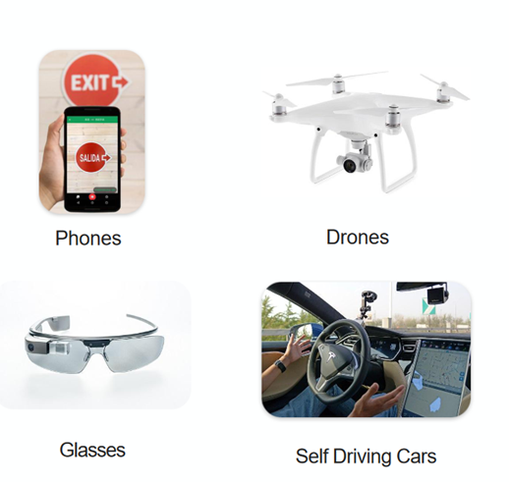
Resource constraints on moving towards edge devices
Memory
Latency
Power Consumption
Bandwidth
Privacy
Image Source: http://isca2016.eecs.umich.edu/wp-content/uploads/2016/07/4A-1.pdf

Slide 7
Do Compressed Neural Networks Perform well?

Slide 8
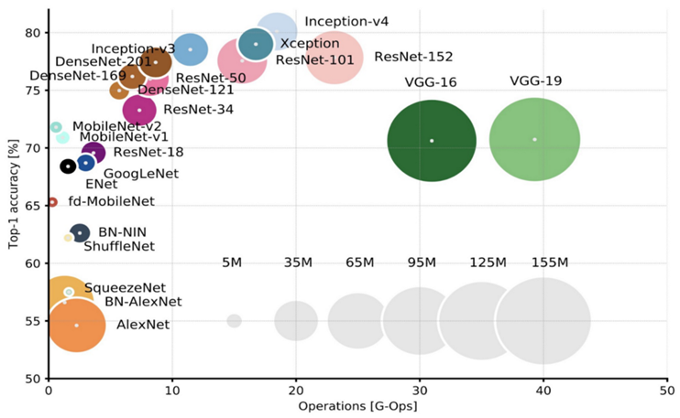
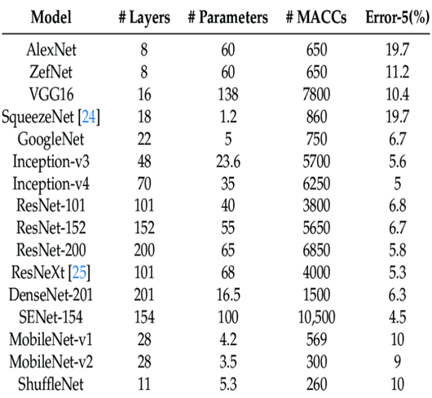
Image Source: https://arxiv.org/pdf/1605.07678.pdf
Véstias, M. P. (2019). A survey of convolutional neural networks on edge with reconfigurable computing. Algorithms, 12(8), 154.

Slide 9
Common Model Compression Techniques

Slide 10
Neural Network Model Compression Techniques
Most common methods:
Pruning
Quantization
Knowledge Distillation
Matrix Decomposition
Other methods:
Parameter Sharing
Special convolution filters/architectures
Architecture search

Slide 11
Pruning

Slide 12
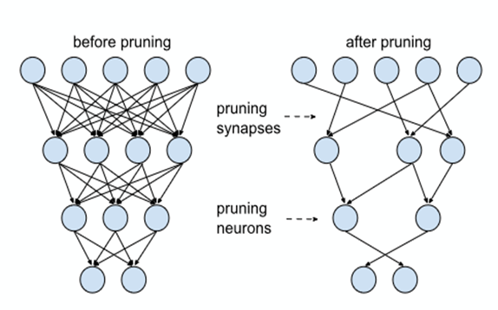
Pruning
Reduce network by removing redundant weights/neurons
Iteratively prune the redundant parameters/layers until desired percentage of pruning or performance
Can be applied for each layer like convolutional, fully connected
Can be applied during or after training
Image Source: http://isca2016.eecs.umich.edu/wp-content/uploads/2016/07/4A-1.pdf

Slide 13
Pruning
AlexNet and VGG on ImageNet[1,2]:
Weight 9-11x smaller
Filter 2-3X smaller
No accuracy loss
Reduce model size upto 90% sparsity
Implementation available in TensorFlow Model Optimization toolkit and PyTorch
[1]- https://arxiv.org/abs/1506.02626
[2] - https://arxiv.org/abs/1608.08710

Slide 14
Quantization

Slide 15
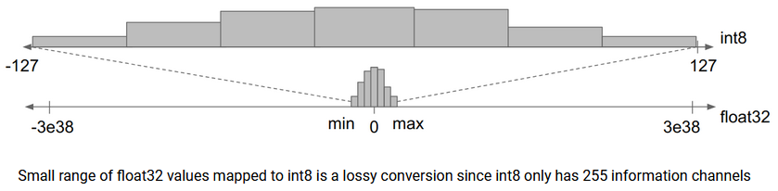
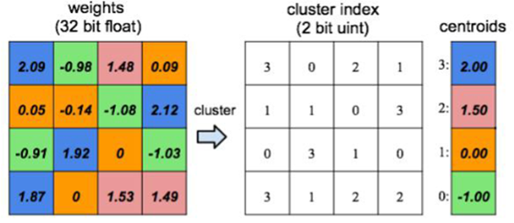
Quantization
Reduce #bits to represent weight and activations
float32-bit -> 16-bit/8-bit/4-bit or 1-bit
Leads to information loss
apply k-means to find the centroids over the weights and replace the index values as weights
Image Source: https://blog.tensorflow.org/2020/04/quantization-aware-training-with-tensorflow-model-optimization-toolkit.html
http://isca2016.eecs.umich.edu/wp-content/uploads/2016/07/4A-1.pdf

Slide 16
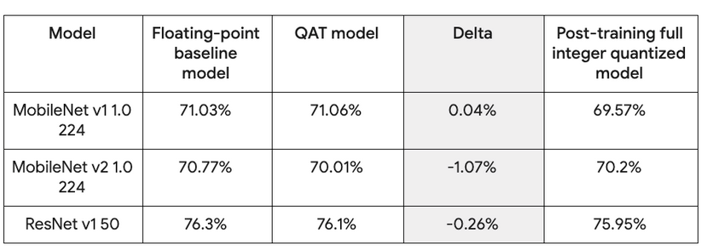
Quantization
Post-training quantization
Quantization-aware training introduces quantization error as noise during training
Implementation available in TensorFlow Model Optimization toolkit and PyTorch
Image Source: https://blog.tensorflow.org/2020/04/quantization-aware-training-with-tensorflow-model-optimization-toolkit.html

Slide 17
Knowledge Distillation

Slide 18
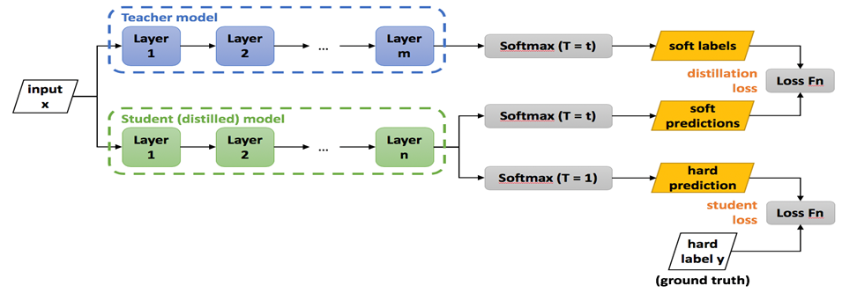
Knowledge Distillation
A large teacher model (mostly pre-trained) transfer the knowledge to small student network [Hinton et.al]
Reduces the model regardless of network architecture differences

Slide 19
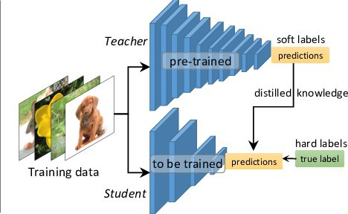
Knowledge Distillation
ResNet on CIFAR10:
46x smaller,
10% less accurate
ResNet on ImageNet:
2x smaller
2% less accurate
TinyBert on Squad:
7.5x smaller
3% less accurate
Open-source libraries
Distiller
Awesome Knowledge Distillation
https://arxiv.org/abs/1802.05668v1
https://arxiv.org/abs/1909.10351v2
Image source - https://towardsdatascience.com/knowledge-distillation-simplified-dd4973dbc764

Slide 20
Matrix Decomposition

Slide 21
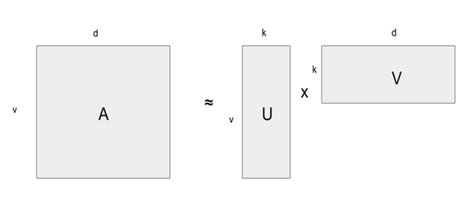
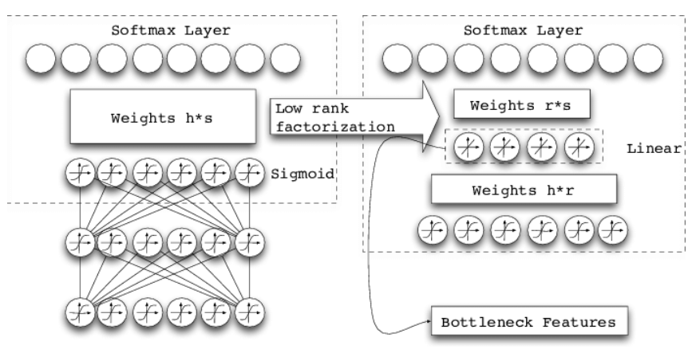
Matrix Decomposition
Factorize large matrices into multiple smaller components
Original weight matrix is decomposed into two thinner matrices
Commonly uses Singular value Decomposition (SVD) and Non-Negative Matrix Factorization (NNMF)
Image Source: https://www.researchgate.net/figure/Diagram-of-the-low-rank-factorized-DNN_fig1_269295146
https://blog.tensorflow.org/2020/02/matrix-compression-operator-tensorflow.html

Slide 22
Deployment

Slide 23
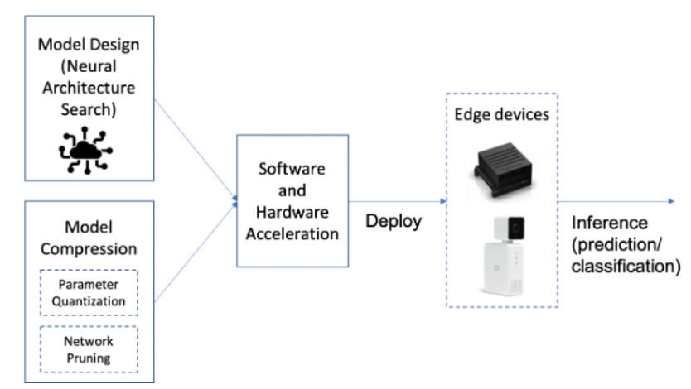
Deployment
Train multiple models targeting different devices
Use native format and frameworks like TFLite on Android
Leverage available GPUs or DSPs
Monitor performance across devices
Put the right model in the right device
https://heartbeat.comet.ml/deep-learning-has-a-size-problem-ea601304cd8
Image Source: https://medium.com/darwin-edge-ai/edge-ai-embedded-hardware-considerations-6a5aa408b824

Slide 24
Conclusion

Slide 25
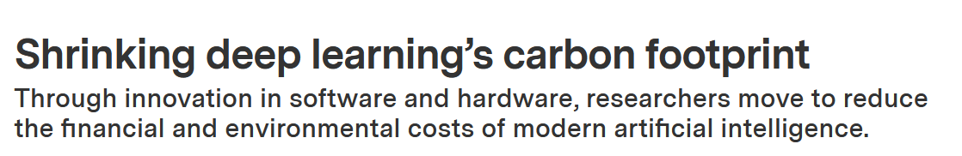
Conclusion
Using efficient network architecture and design
Combining multiple compression methods yield good performance
Hardware designed for efficient deep networks
Going towards leaner, greener algorithms...
https://news.mit.edu/2020/shrinking-deep-learning-carbon-footprint-0807

Slide 26
Questions
Q: How does Pruning and Quantization help to reduce the model size?
A: Pruning does sparsifying the weights/neurons to zero values. In Quantization the weights are represented using reduced bits like int8 instead of float32. So the size of the model is reduced by reducing the parameter count and its representation.
Q: What is Knowledge Distillation and how does it work?
A: In knowledge distillation, a large pre-trained teacher model distills its knowledge to the smaller student model. The teacher network's predictions are given as inputs to the student model during training to optimize along with the hard ground truth labels. This helps the student network to mimic the teacher and produce improved performance.

Slide 27
References:
https://towardsdatascience.com/how-to-compress-a-neural-network-427e8dddcc34
https://towardsdatascience.com/model-compression-needs-and-importance-6e5913996e1
https://heartbeat.comet.ml/deep-learning-has-a-size-problem-ea601304cd8
https://www.technologyreview.com/2019/06/06/239031/training-a-single-ai-model-can-emit-as-much-carbon-as-five-cars-in-their-lifetimes/
https://news.mit.edu/2020/shrinking-deep-learning-carbon-footprint-0807
https://www.humanizing-ai.com/model-compression.html

Slide 28


Thank You
@sriran_ramkrish
Sriranjani Ramakrishnan

